Slide 1




Identifying Duplicate Questions
With the growing popularity of question-and-answer sites/communities (Reddit, Stack Overflow, Quora, etc.), similarly worded questions have become a very common occurrence. Weeding out duplicates can provide a better experience on these sites.
Seekers often spend a lot of time searching for answers. Identifying and displaying similar questions that have already been answered, saves time and increases satisfaction.
Writers feel that they need to answer multiple versions of the same question.
Enabling them to tag multiple similar questions to their answer, allows them to make more of an impact.
Analytics Solution: A classifier to predict whether two questions have the same intent
Notes:
TD

Slide 2
Question Similarity Engine
1. Raw Data
2. Feature Engineering
3. Machine Learning
4. Interactive App
400K Question Pairs
Duplicate Label
Natural Language Processing
Number of Shared Words
Difference in Readability Scores
TF-IDF Vectorization
Cosine Similarity
Named Entity Recognition
BERT Embeddings
Classification Models
Logistic Regression
Random Forests
Gradient Boosting
Hyperparameter Tuning
Evaluation Criteria
Accuracy
Recall
AUC for ROC Curve
Recommender
User Enters a question
Model suggests top 5 similar questions based on predicted probability
See python notebook: “Question Similarity Engine.ipynb”
Notes:
TD

Slide 3

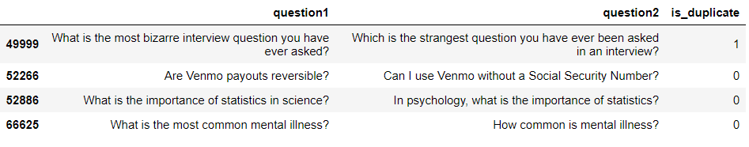
1. Data: Quora Question Pairs
Since there are only two text input variables, feature engineering using NLP is critical
Human labeled dataset with 400k pairs of actual questions asked on Quora
36.92% of this dataset contains duplicate pairs of questions
Notes:
TD

Slide 4
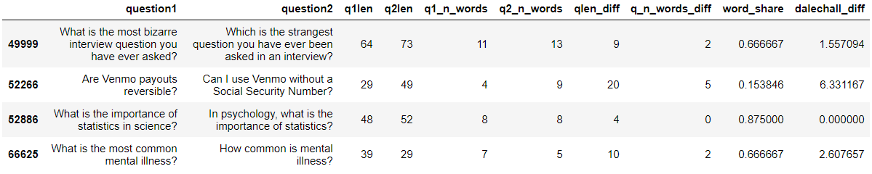
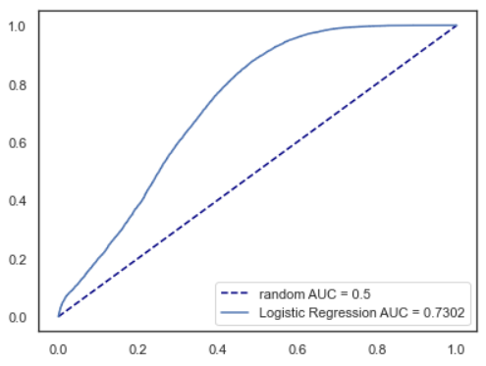
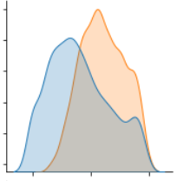
2A. Feature Engineering: Initial Variables
Initial variables were used to build a baseline logistic regression model, which yielded an accuracy of 67% an AUC of 0.73
word_share vs is_duplicate flag
Initial logistic regression model, AUC: 0.73
Notes:
TD

Slide 5
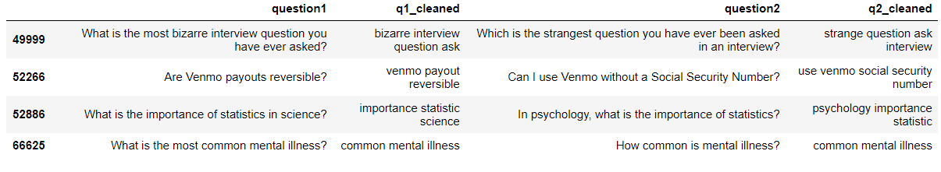
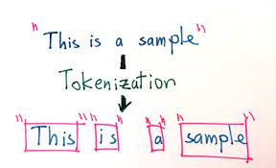
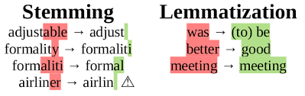
2B. Feature Engineering: Pre-processing
Questions were pre-processed by tokenization, lemmatization and removal of stop words using nltk and spacy libraries
Tokenization
Stemming & Lemmatization
Notes:
TD

Slide 6
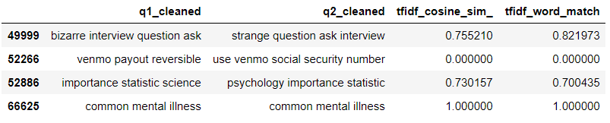
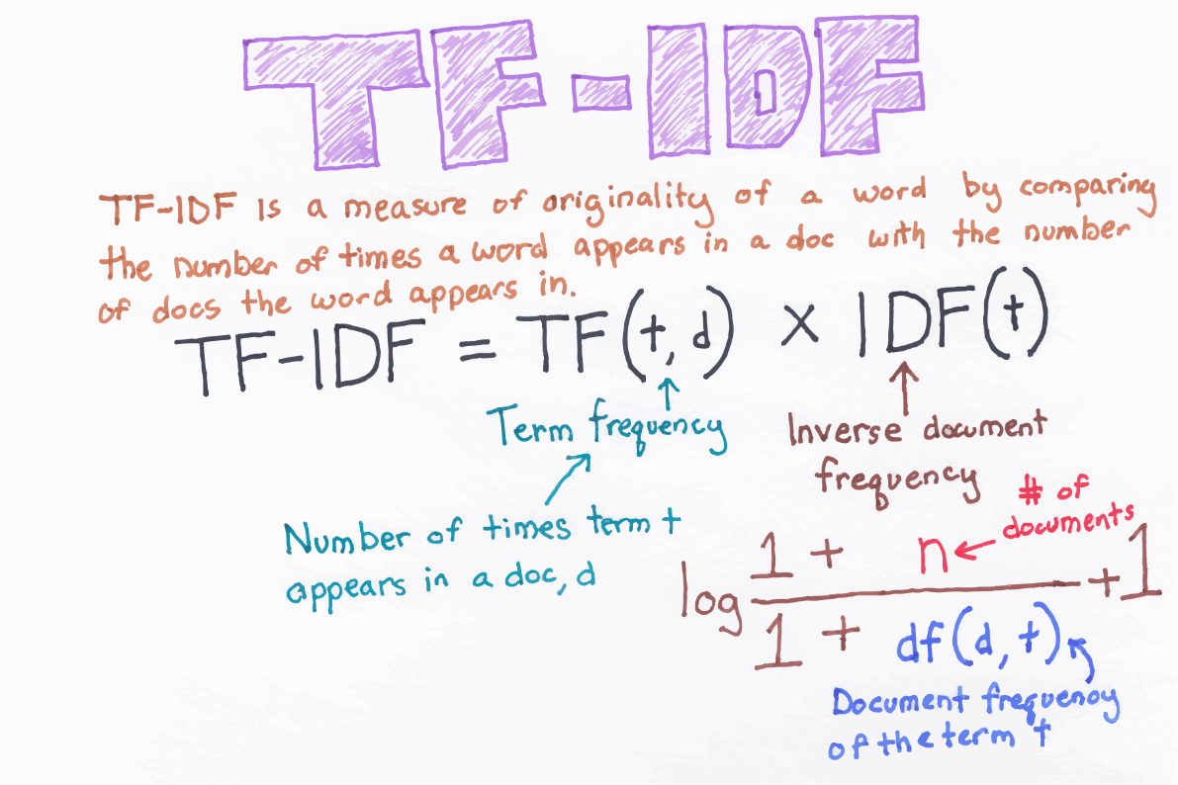
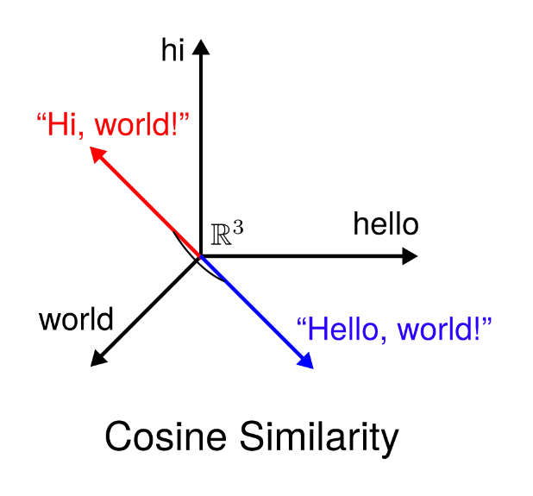
2C. Feature Engineering: TF-IDF Vectorization
Tf-idf is a combination of term frequency and inverse document frequency. It assigns a weight to every word in the document, which is calculated using the frequency of that word in the document and frequency of the documents with that word in the entire corpus
Calculating Similarity between two vectors
Notes:
TD

Slide 7
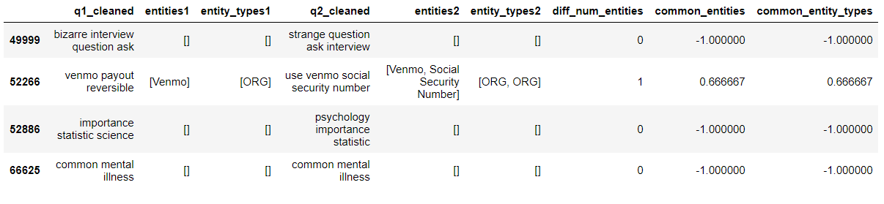
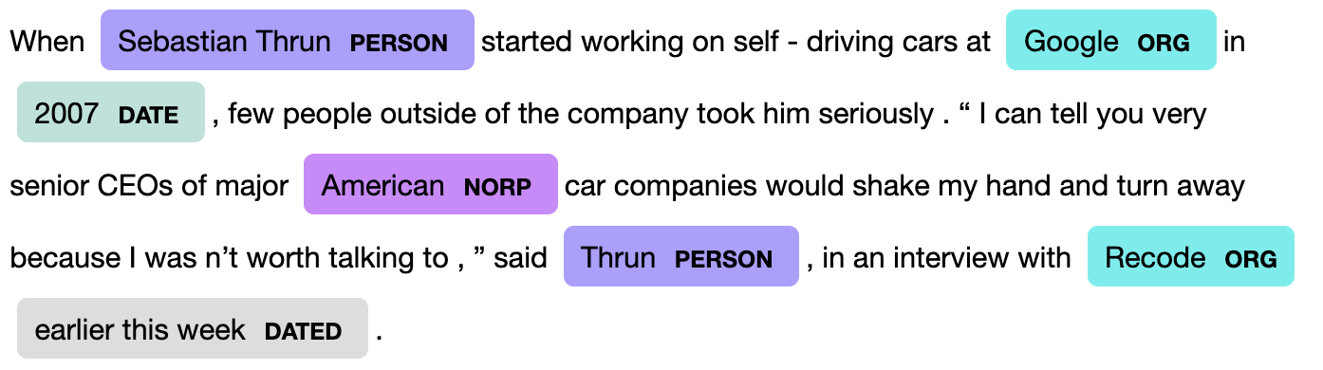
2D. Feature Engineering: Named Entity Recognition
NER is an information extraction technique to identify and classify named entities in text, with the hope that questions with matching entities are more likely to be duplicates.
Color-coded recognized entities
Notes:
TD

Slide 8
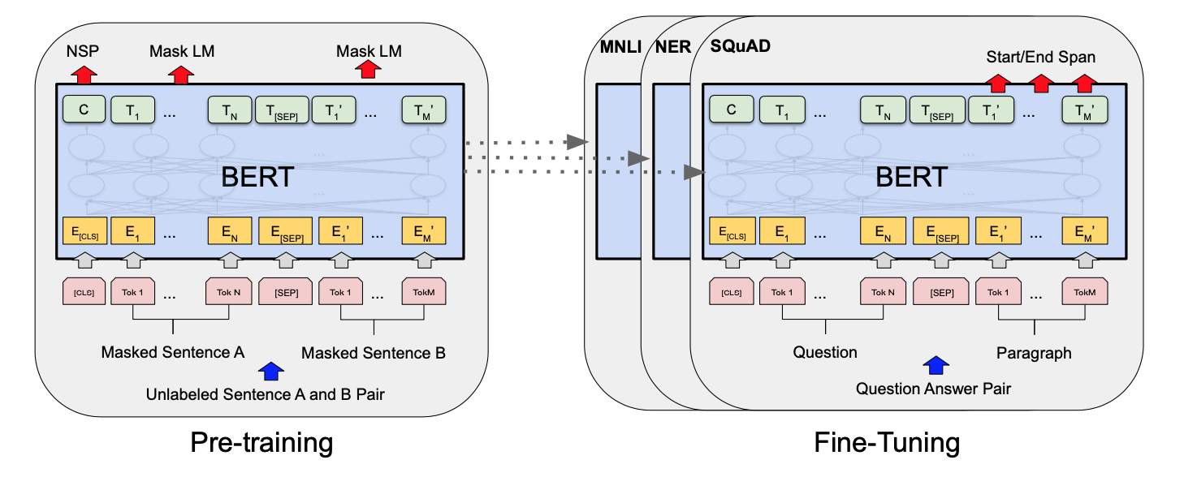
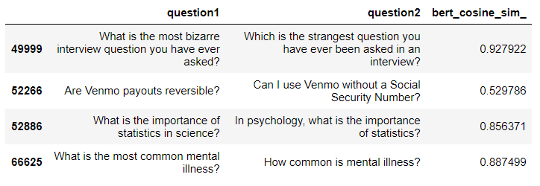
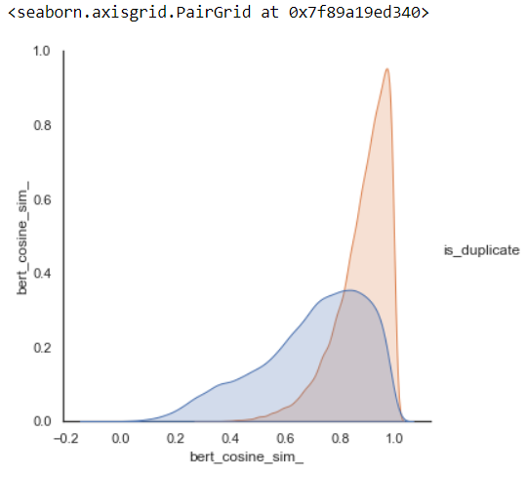
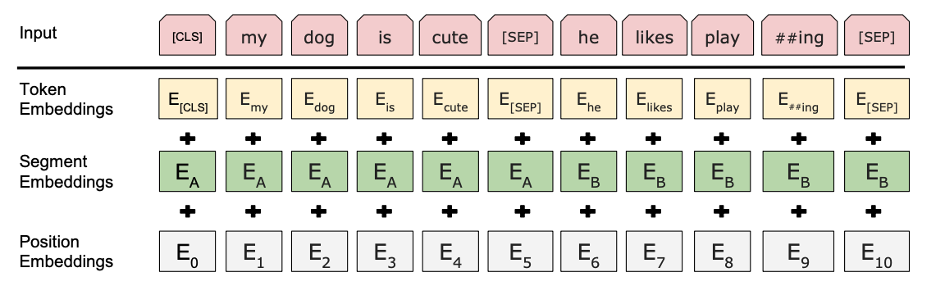
2E. Feature Engineering: BERT Embeddings & Cosine Similarity
Huggingface’s pre-trained BERT base model, which has 12 layers (transformer blocks), 12 attention heads, 110 million parameters and hidden size of 768, was used to obtain embeddings
BERT training architecture (Image from https://arxiv.org/pdf/1810.04805.pdf)
BERT Cosine Similarity does a decent job of differentiating between class labels
BERT input representation (Image from https://arxiv.org/pdf/1810.04805.pdf)
Notes:
TD

Slide 9
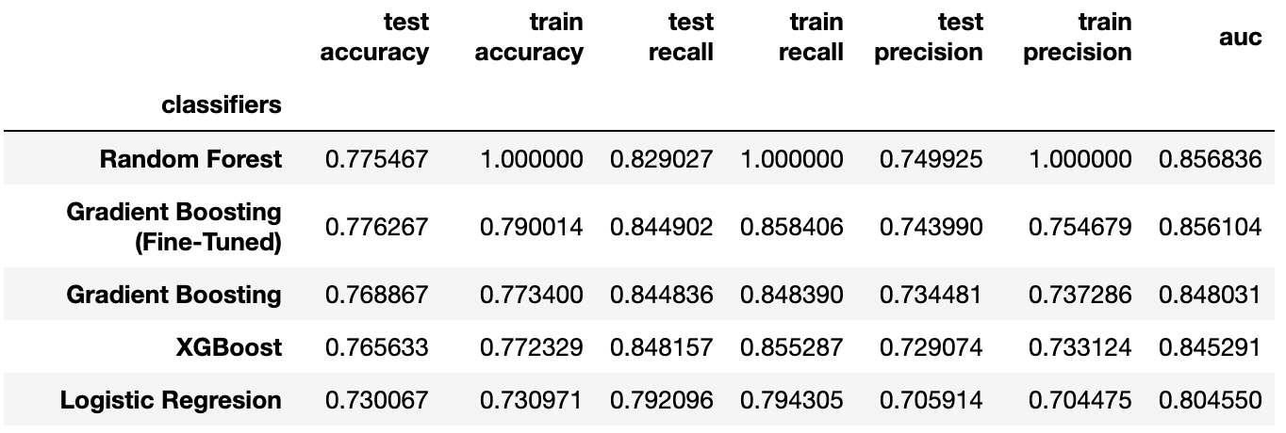
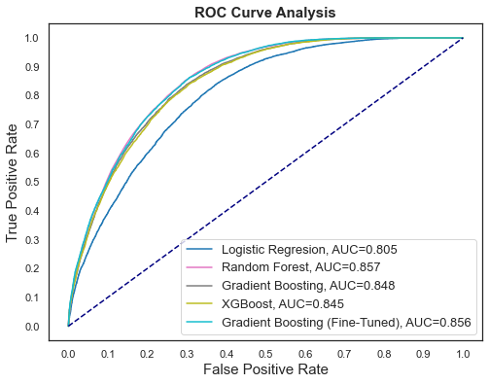
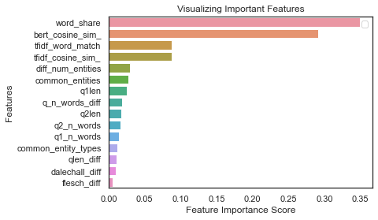
3. Machine Learning: Building & Comparing Classification Models
Notes:
TD

Slide 10
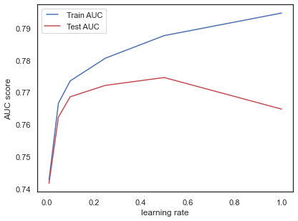
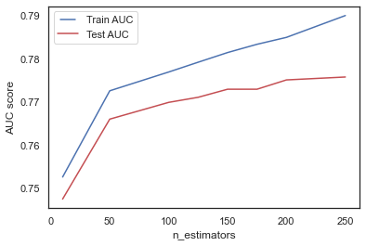
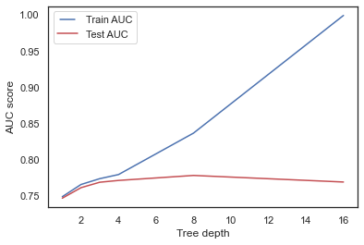
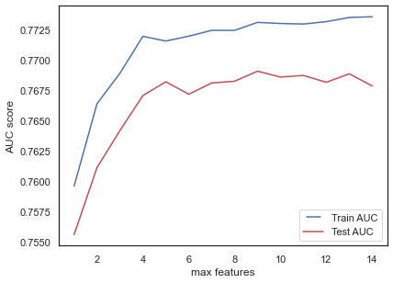
3. Machine Learning: Tuning Parameters
learning_rate
This determines the impact of each tree on the final model
Lower values make the model robust to the specific characteristics of tree but require a larger number of trees and are computationally expensive
n_estimators
The number of sequential trees to be modeled
Though GBM is fairly robust at higher number of trees but it can still overfit at a point
max_depth
The maximum depth of a tree.
Used to control over-fitting as higher depth will allow model to learn relations very specific to a particular sample.
max_features
The number of features to consider while searching for a best split
As a thumb-rule, square root of the total number of features works great but we should check up to 30-40%
Higher values can lead to over-fitting but depends on case to case
Final Model:
GradientBoostingClassifier(learning_rate=0.1,n_estimators=256,max_depth=4,max_features=5)
Notes:
TD

Slide 11
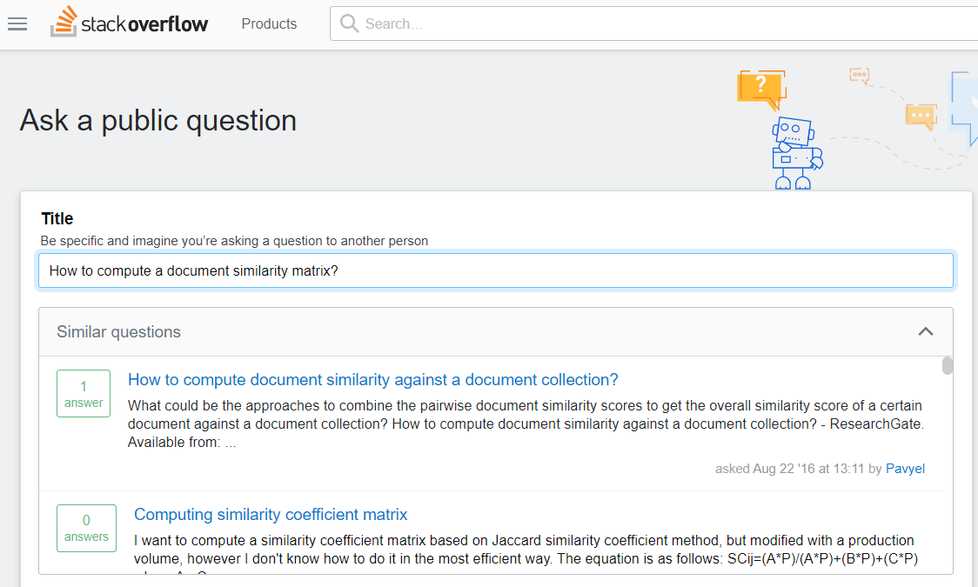
Applications: Q&A Websites
Q&A Websites like Quora, StackOverflow
Notes:
TD

Slide 12
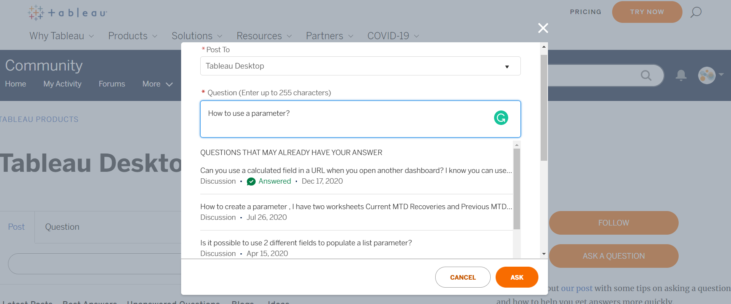
Applications: Product Support Communities
Community sections for software/platform companies (such as Tableau) can leverage this solution to maintain a single source of truth and increase customer satisfaction
Notes:
TD

